Slide 1

AI Chat Bot Using API: Gemini Free Chatbot:
Welcome to the world of AI chatbots with Gemini. This presentation offers a comprehensive overview of Gemini, Google's cutting-edge AI model. Designed for developers, tech enthusiasts, and business professionals, it explores Gemini's features, setup, and real-world applications.

Slide 2

Introduction to Gemini Chatbot
Google's AI Model
Growing Importance
Gemini is a cutting-edge AI model by Google. It excels in natural language processing and understanding.
AI chatbots are increasingly important in various industries such as customer service and education.
The global chatbot market is projected to reach $102B by 2026.

Slide 3
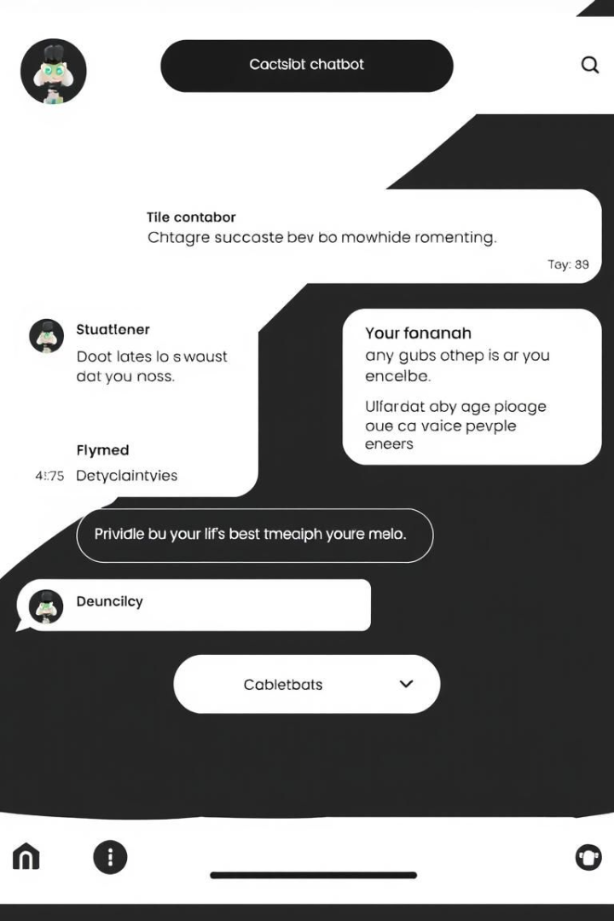
What is Gemini Free Chatbot?
Accessible Version
Ease of Use
Gemini Free Chatbot is an accessible version of the advanced Gemini AI model.
It's designed for experimentation, learning, and simple application development.
Limited Usage
The free tier offers limited usage compared to paid plans.
It provides an entry point for developers and users to explore AI capabilities.

Slide 4
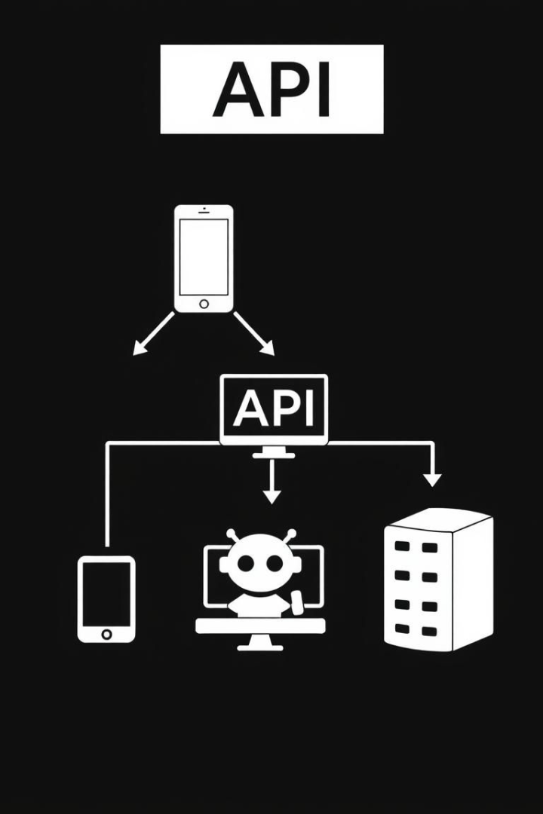



Understanding APIs in AI Chatbots
Messenger
APIs are like messengers, enabling communication between applications.
Communication
APIs enable communication between Gemini and your application.
Access
APIs are essential for chatbots to access AI models like Gemini.
Specific API endpoints include text generation and language translation.

Slide 5
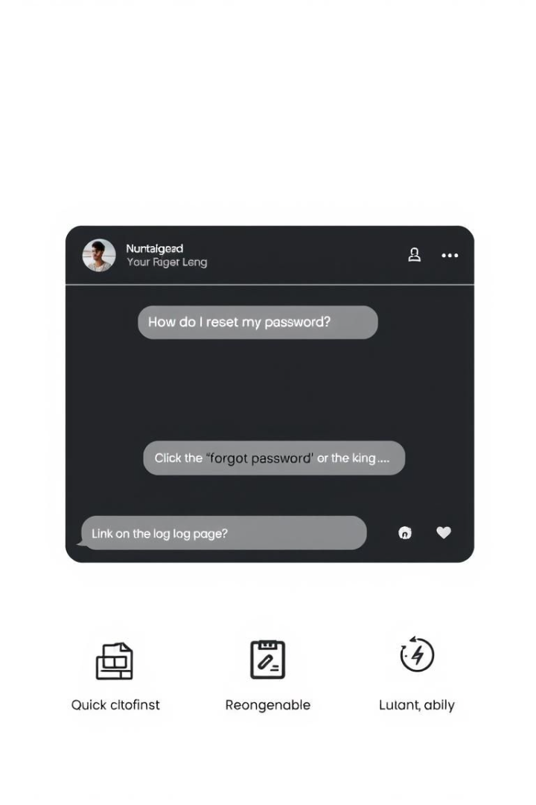
Key Features of Gemini Free Chatbot
Natural Language Understanding
Text Generation
Generates and summarizes text with a 2000+ character limit.
NLU allows the chatbot to interpret user input effectively.
Sentiment Analysis
Determines the sentiment of text as positive, negative, or neutral.
It supports over 100 languages and integrates with popular platforms.

Slide 6




Setting Up Gemini API for Chatbot Development
Create Google Cloud Account
Sign up for a free tier account on Google Cloud.
Enable Gemini API
Enable the Gemini API in the Google Cloud Console.
Obtain API Keys
Get your API keys, ensuring secure storage practices.
Install necessary libraries, such as the Python client library.

Slide 7




Integration Steps: Connecting Gemini to Your Chatbot
Handle Responses
2
Manage responses and errors effectively.
Send Requests
1
Send requests to the API endpoints.
Code Examples
Use Python or JavaScript for text queries.
3
Utilize tools like Postman for testing API calls during integration.

Slide 8




Use Cases of AI Chatbots Powered by Gemini
1
Customer Support
2
Education
3
Content Creation
Examples: Automating FAQs, personalized learning assistance, and blog post ideas.

Slide 9

Advantages & Challenges of Using Gemini Free Chatbot
Advantages
Challenges
Cost-effective for experimentation
Limited usage quota
Potential latency issues
Easy to use and integrate
Dependence on internet
Access to advanced AI capabilities
Despite its challenges, it offers a valuable entry point into AI chatbot development.

Slide 10

Conclusion: The Future with Gemini Chatbots
Encourage Exploration
Reiterate Potential
Recap Key Points
Explore, experiment, and innovate with Gemini in your projects. The resources and further learning links offer a great starting point.

